Slide 1

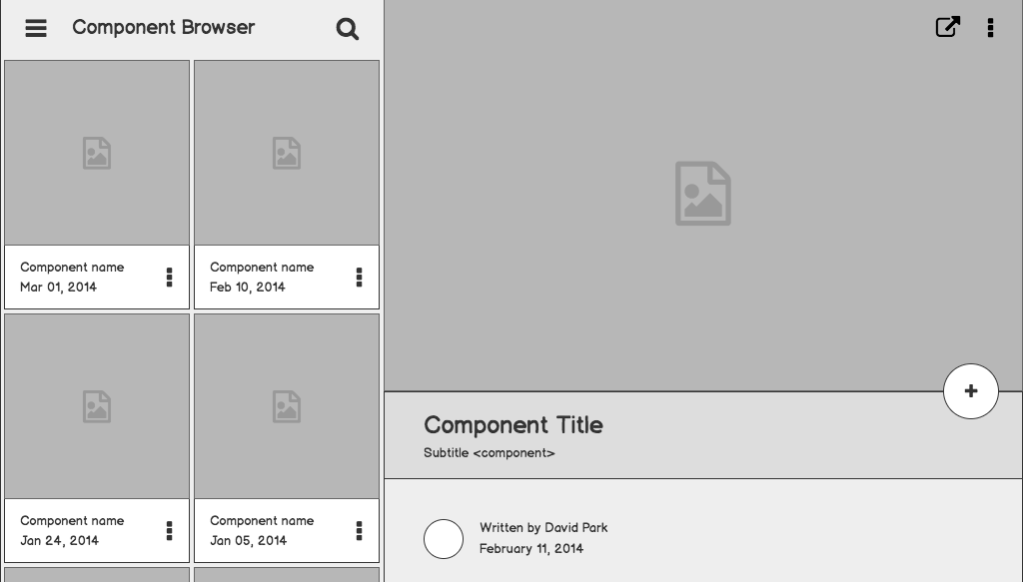


Investment Decision Recommendation System Project
KIRUTHIKA V G
21PT10

Slide 2
Problem statement
To build a recommendation system that can predict the best investment decision for new data based on various factors available in the dataset.

Slide 3
FINDINGS
Demographic Distribution
Gender Distribution: Nearly equal distribution between male and female investors.
Marital Status: Majority of investors are married.
Age Distribution: Most investors fall within the middle-aged to elderly range.
Employment Roles: Diverse employment roles among investors.

Slide 4
FINDINGS
Investment Patterns
Income Distribution: Wide range of household incomes among investors.
Percentage of Investment: Varied percentages of household income invested.
Sources of Awareness: Television and family references are prominent sources of investment awareness.

Slide 5
FINDINGS
Knowledge Levels: Majority of investors have moderate to high knowledge levels about different investment products.
Investment Influencers and Risk Levels
Influencers: Family references and other personal networks play significant roles in investment decisions.
Risk Levels: Most investors have medium to low-risk tolerance levels.

Slide 6
METHODOLOGY
Data Preprocessing
Cleaning: Removed null values and duplicate entries.
Feature Engineering: Extracted lower and upper bounds of income for analysis.
Normalization: Standardized percentage of investment using StandardScaler.
Label Encoding: Converted categorical variables to numerical using LabelEncoder.
Model Selection
Random Forest Classifier: Chosen for its ability to handle non-linear relationships, handle large datasets, and provide feature importance insights.
Evaluation Metrics
Accuracy, Precision, Recall, F1-score: Used to assess the model's performance on both training and new data.
1

Slide 7
METHODOLOGY
Recommendation System's Performance
Model Performance: Achieved an accuracy of X% on the test set.
Precision, Recall, F1-score: Provided insights into the model's ability to correctly predict investment decisions.
1

Slide 8
INSIGHTS AND RECOMMENDATIONS
Investment Awareness: Increase awareness through targeted campaigns, leveraging popular media channels like television.
Risk Management: Provide education and resources to help investors better understand risk levels and make informed decisions.
Diversification Strategies: Encourage investors to diversify their portfolios based on their risk tolerance levels and investment goals.
Continuous Monitoring: Implement systems for continuous monitoring and adjustment of investment strategies based on market conditions and investor preferences.
1

Slide 9
AREAS OF IMPROVEMENT AND FUTURE RESEARCH
Feature Engineering: Explore additional features or transformations to enhance model performance.
Ensemble Techniques: Experiment with ensemble methods to further improve predictive accuracy.
Dynamic Recommendation: Develop a dynamic recommendation system that adapts to changing market trends and investor preferences.
User Feedback Integration: Incorporate user feedback mechanisms to refine recommendations over time.
1

Slide 10
CONCLUSION
The investment recommendation system provides valuable insights and guidance for making informed investment decisions. By leveraging demographic information and investment patterns, investors can optimize their portfolios and achieve their financial goals effectively.

